Slide 1
Computer Science 20
Introduction

Slide 2
Why study computing?
Develop new set of problem solving skills
Improve logical thinking
Strengthen mathematical abilities
Gain deeper fluency with technology
Not just use, but to create
See how we can use computing to accomplish some amazing things!

Slide 3
How do we solve problems?
PROBLEM-SOLVING ACTIVITY
Working with a neighbour, consider the following problem: “You are Hungry”
Get out a piece of paper and write your names on it. Write out the steps for your solution.
I’ll ask one or two groups to share theirs with the class.

Slide 4
Procedural Solutions
There are some features that are common to many of our solutions:
Algorithm is a series of distinct steps
How much detail is enough? How much is too much? (Abstraction)
Also, simply finding a solution is not always good enough!
Some solutions are better than others
(Readability, Efficiency, Elegance)

Slide 5

Where should we start?
We will learn how to use a programming language, and then see how we can write programs to solve complex problems.
We’ll start with Scratch, a block-based language developed at MIT.
To begin, sign up for our Scratch digital class space. Link is on Canvas.

Slide 6
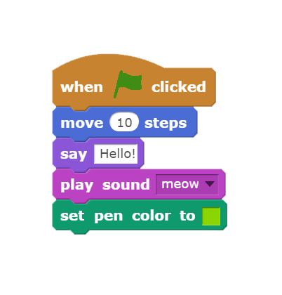
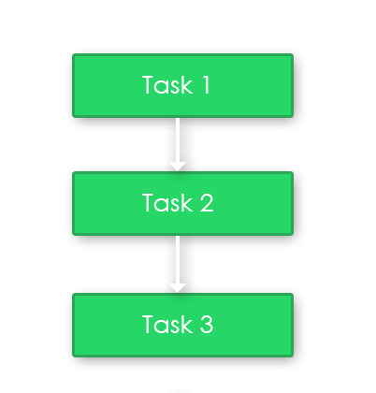
Sequential Instructions
Algorithms for completing a task often include a sequence of instructions that are completed one after another.
The program will move on to the next instruction only when the current one is ‘complete’.

Slide 7
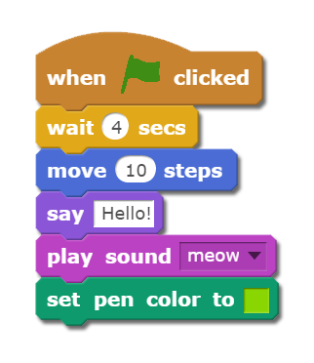
Controlling Sequence Timing
In Scratch, once an instruction in a sequence is complete, the next one in the script will execute.
To delay the execution of a subsequent block, one way is to use a wait (delay) block.

Slide 8
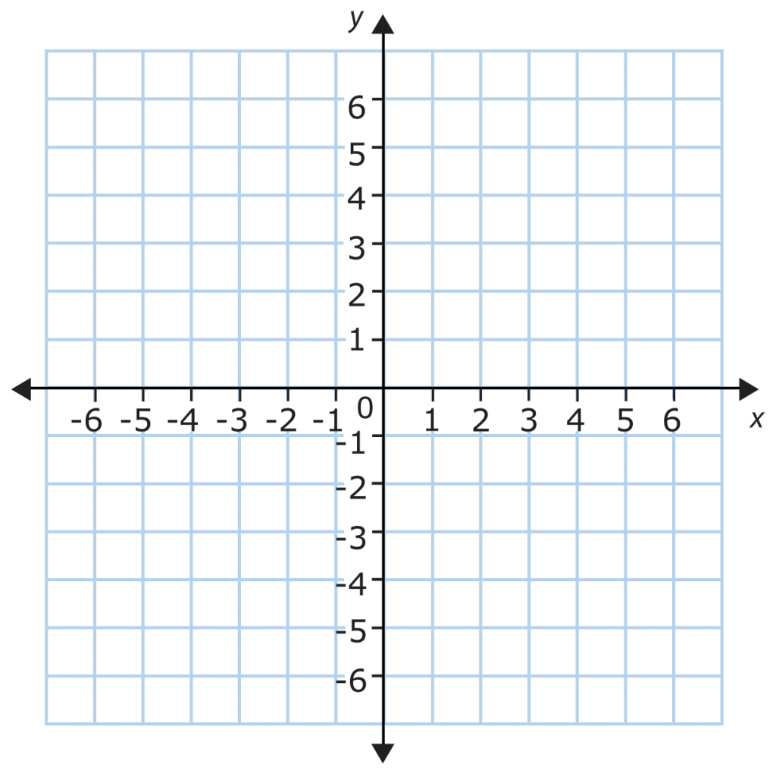
Coordinate Systems
There are several different systems for describing a visual location in space.
Scratch uses the Cartesian Coordinate System, where the origin (0,0) is located in the very middle of the stage.
Stage size is 480x360 pixels.

Slide 9
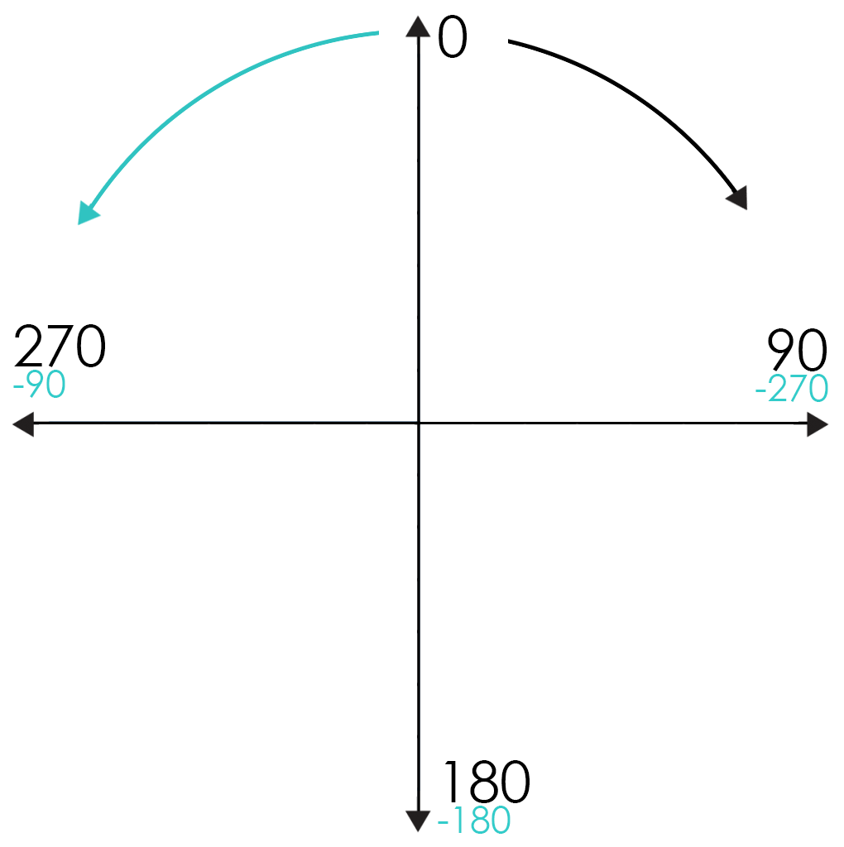
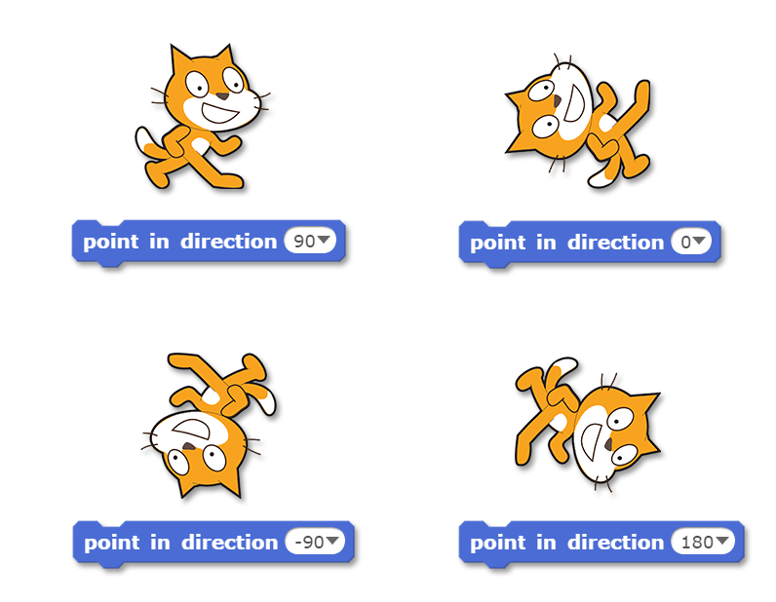
Directions
Directions in Scratch are described using the following compass angles:

Slide 10
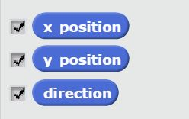
Knowing where a sprite is
Each sprite has the following motion properties:
X position – the sprite’s horizontal location.
Y position – the sprite’s vertical location.
Direction – the current way that the sprite is facing.
Toggling the checkbox will display the current value on the stage
Good for debugging!
These blocks can also be used inside certain other blocks…

Slide 11
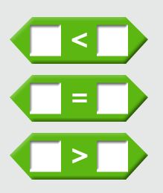
Demo
Shrinking the “Edges”
We can easily have our sprite bounce when an edge is detected, but what if we want it to bounce somewhere else?
We can use the sprites position (X position, Y position) with a comparison

Slide 12
Exercise
Bouncing Art Sprite
Create a program with one sprite
When the Green Flag is pressed:
The sprite should begin at the origin (0,0) and choose a random direction to move.
The pen should be used to draw a trail of its motion.
When the wall is encountered, bounce.
As well, include the following features:
Pressing space should pick a new random direction.
Pressing Z should decrease the pen size, and X should increase the pen size.
Pressing C should change the pen to a new color.

Slide 13
Extend our Your Program
If time allows, try creating additional scripts that will run when a certain key is pressed:
To modify the pen color and size
To perform an image effect (and reverse it?)
To point the sprite in a new direction

